Slide 1

Marketing the Ford Ka
Compare Clustering Solutions
Demographics versus Psychographics

Slide 2
1. Summary of the psychographic data (not all of it, just a plot or two, or summary statistics that you think are quite instructive/insightful/illustrative)
2. Summary of your k-means. Please do not just show just the centroids but what you learn from the centroids and how they help you understand/summarize the data. Give your centroids names and/or images to help identify them.
3. How do you know your cluster is a good one? (specifically what type of validation did you do to show it is good?)

Slide 3
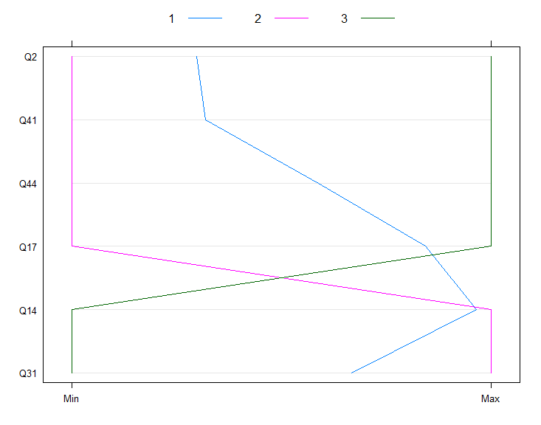
Visualizing our Data
Survey Groups:
Top 3 (Buyers)
Bottom 3 (Non-buyers)
Middle 4 (Fence)
We find some interesting patterns in the data:
Survey participants that ranked the Ford Ka among their top 3 options were looking for performance and were not as concerned with fashion or car-size
Those who
Versicolor’s are in between, but are more like Virginica’s than Setosa’s
Q2. I am fashion conscious.
Q14. The car I buy must be able to handle long motorway journeys.
Q17. I want a car that is nippy and zippy.
Q31. I want a comfortable car.
Q41. In today's world it is anti-social to drive big cars.
Q44. I want to buy a car that makes a statement about me.

Slide 4
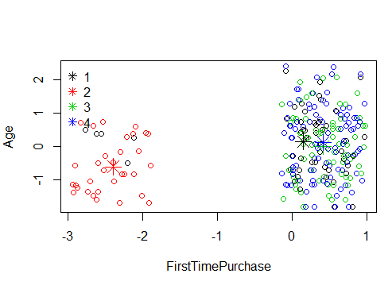
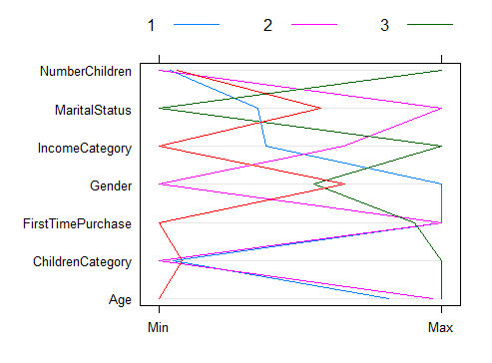
Demographic Data

Slide 5

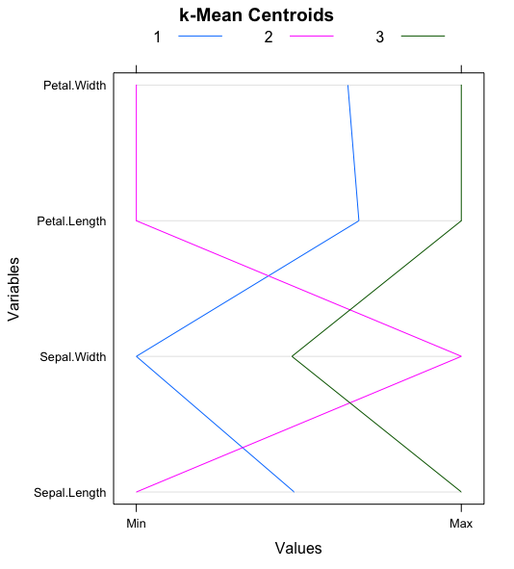
Customer Segmentation
What are your clusters?
What do your clusters mean?
Cluster | Meaning
1 | Long petaled flowers best for hillsides
2 | Medium flowers useful for massing
3 | Small flowers great near homes
State this in plain words that non-technical users can understand. Try using pictures or labels to summarize each cluster.
Experiment with tables and graphs to illustrate and contrast the clusters

Slide 6
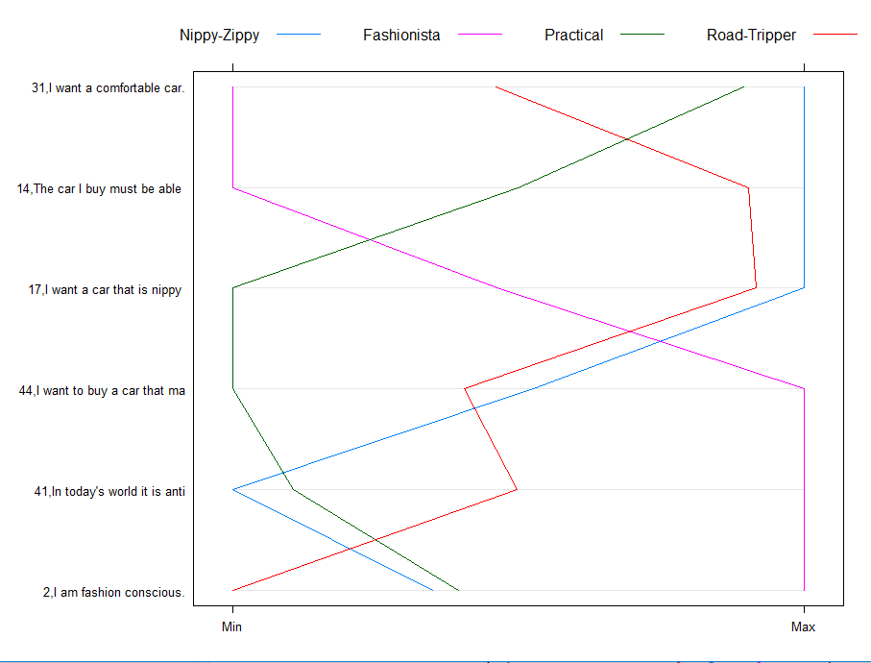
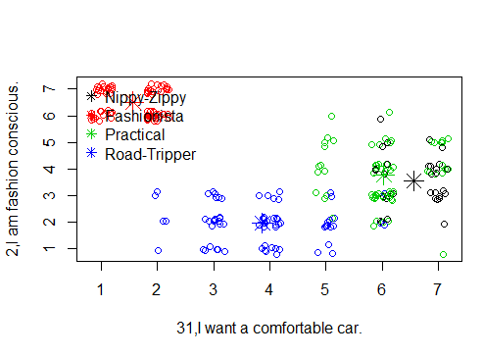
Customer Segmentation
What are your clusters?
What do your clusters mean?
# | Title | Meaning
1 | Nippy-Zippy | Performance driven, looking for a driving experience and the best features
2 | Fashionista | Think of their car as an identity statement, trend conscious, like to stand out, and are mainly city drivers
3 | Practical | Comfort driven, not big on fashion. More utility driven and looking for dependability
4 | Road Tripper | Expect to get a lot of miles out of their vehicle. Place no value in fashion

Slide 7
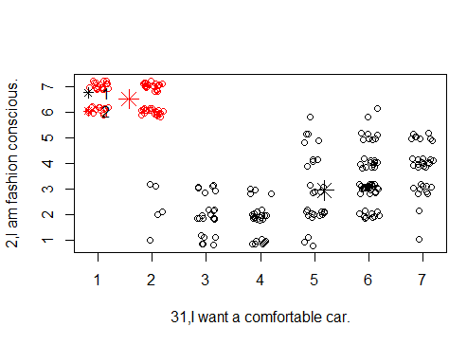
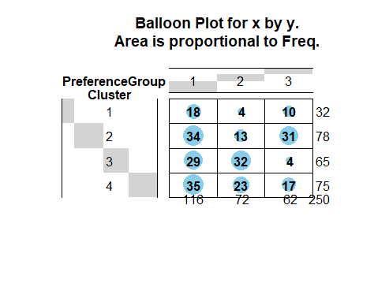

Slide 8
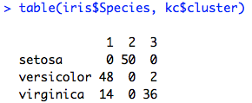
Recommendation of Clustering Solution
There is a strong association between the cluster solution and the species of Iris.
Our confusion matrix shows a strong relationship between “1” and versicolor, “2” and setosa, and “3” and virginica
The validity of our clustering solution is demonstrated by our ability predict the taxonomy developed by expert botanists.

Slide 9
Recommendation of Clustering Solution
We recommend clustering on psychographic dimensions.
Cluster 2 (Fashionistas) is the recommended segment to target as it has the greatest number of choosers and neutrals who can be influenced. This segment also aligns with the target audience that Ford is trying to win over from the Renault Twingo.
Cluster 1 (Nippy-Zippy) appears to be the natural buyers for the Ford Ka, with 56% of individuals rating the car in the top 3 and 31% rating it in the middle.
However, this cluster is relatively small and thus should be a secondary focus for Ford.
In addition, the cluster is fundamentally different than Cluster 2, so creative marketing will be required to reach both segments at the same time.

